Slide 1

PRESENTING
Care
Groups
Offers a complete range of healthcare management features for patients, doctors, and admins.

Slide 2

OUR TEAM
SABA
HAFSA ABID LODHI
ANMOL NAZ
SHAH MIR HASSAN
SYED JAWAD
INSHAL MUSTAFA

Slide 3



Key Objectives
Streamlined Record Management
The main objective of this project is manage the records of patients doctors and appointments.
Doctor availability and appointments
Our objective is by using this website patients can search and view doctors and also apply for appointments.
Easy Access to Digital Records
Reduce the paper work and provide the 27*7 accessible website with user friendly GUI (Graphical User Interface) to manage the records.

Slide 4


Healthcare Challenges
Patients face difficulties in finding available doctors and booking appointments.
Medical records are often scattered across different systems.
Communication gaps between patients and healthcare providers can lead to misunderstandings regarding treatment plans and appointment details.
Hospital administration faces challenges in managing patient data, doctor availability, and appointment records, leading to errors and increased paperwork.

Slide 5

FEATURES ADDRESSING KEY CHALLANGES
Enhanced Patient Access Centralized platform for searching and booking appointments..
Streamlined Communication Secure messaging features foster clear communication between patients and healthcare providers .
Reduced Administrative Burden The website’s administrative tools simplify data management, freeing up staff to focus on patient care rather than paperwork.
Record Management Centralized patient records minimize paperwork and allow healthcare providers to quickly access information.
Medical History Access Secure platform for easy access to medical history.
24/7 Accessibility Round-the-clock access to healthcare services.

Slide 6
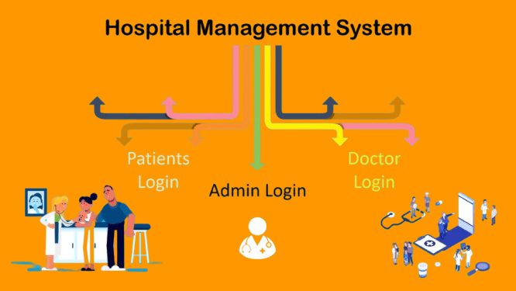

Slide 7
Admin Modules
01
Dashboard
Provides a comprehensive view of doctors, patients, and appointments for efficient monitoring.
02
Register Doctor & Patients
Enables the admin to add new doctors , including their details and specialties and create patients profiles and manage their information.
03
Edit Doctors & Patients
Admin can update information for doctors and has the authority to remove doctors and can modify patient information for up-to-date records and can remove patient profiles from the system.
Manage Disease Details
04
Allows updates to the disease section on the website, providing users with current medical information.
Delete Doctors & Patients
05
Provides control to remove outdated or unnecessary records securely.

Slide 8


Patient Modules
Registration & Login
1
Patients can create an account and securely login to the system.
View Profile
2
Patients can access their profile details.
Update Profile
3
Patients can also update their personal information.
4
Appointment Booking
Patients can easily schedule appointments with available doctors.
Search Doctors
5
Allow patients to view doctors by specialty and availability.

Slide 9
Doctor Modules
AUTHENTICATION
1
Doctors can securely login to access their dashboard.
PATIENT REGISTRATION
2
Doctors can add new patients to the system as needed.
PATIENT MANAGEMENT
3
Doctor can update patient information for accurate record-keeping.
PROFILE MANAGEMENT
4
Doctors can modify their personal and professional details.
APPOINTMENT MANAGEMENT
5
Doctors can accesss their schedule and view upcoming patient appointments.

Slide 10
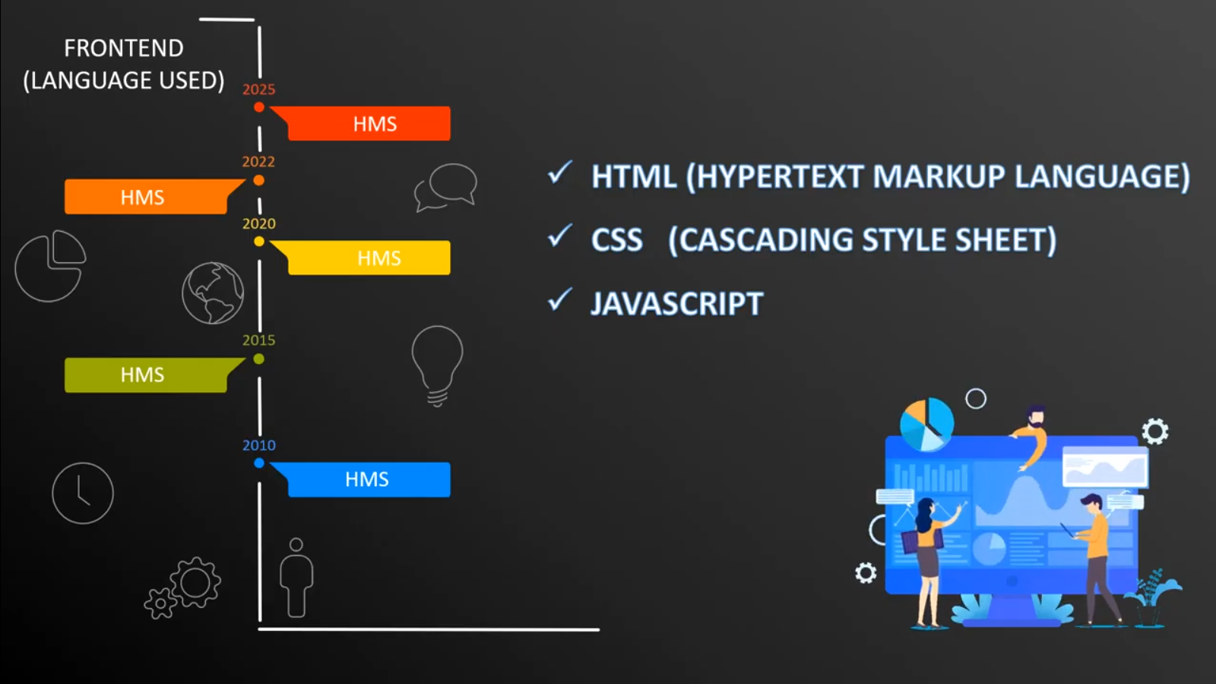

Slide 11
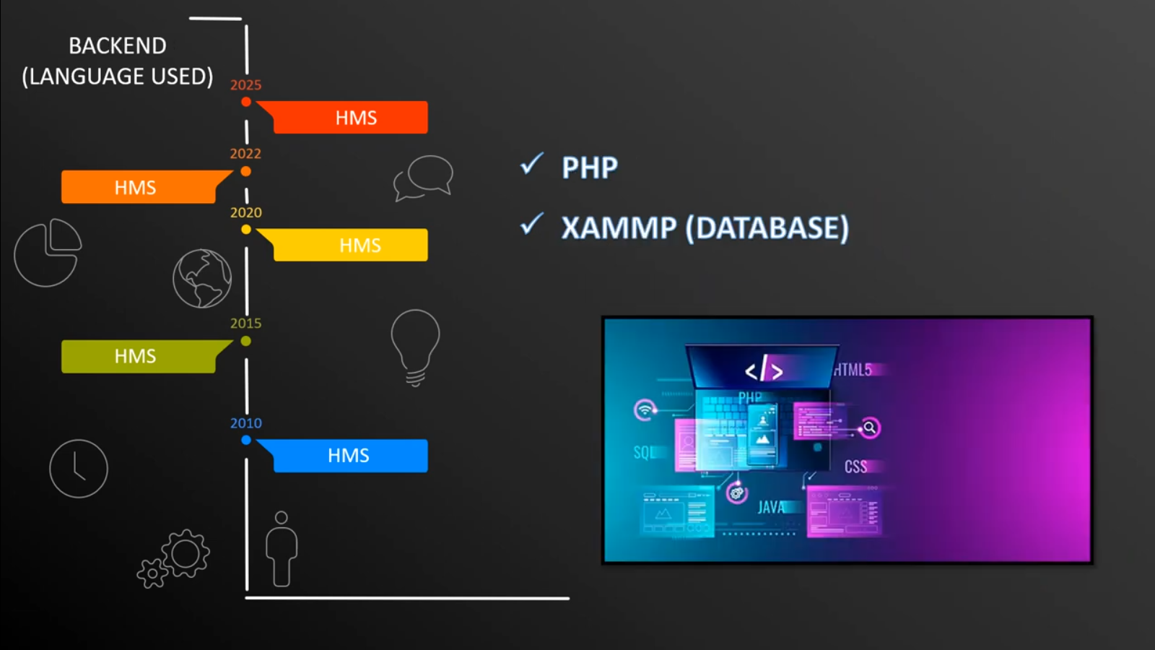

Slide 12
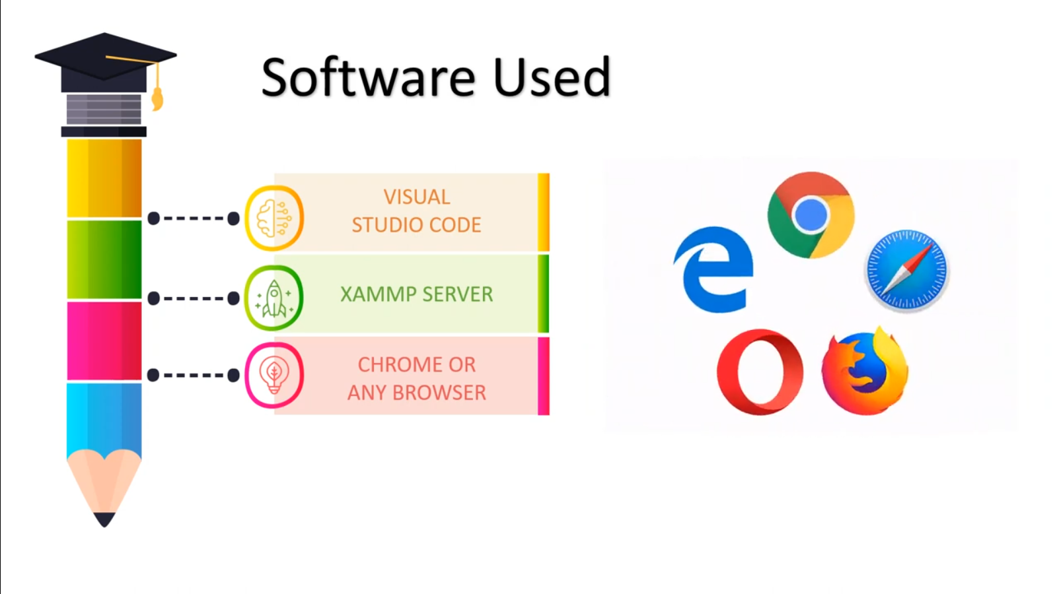

Slide 13

Project Summary
Our hospital website addresses key challenges in healthcare, from patient access to administrative efficiency, providing a user-friendly platform for patients, doctors, and administrators alike.
Empowering Accessible Healthcare
Ongoing Development & Growth

Slide 14

Thank
You.
For Your Attention
www.caregroup.com

